Slide 1
Blockchain and Secure Digital Currency: Bitcoin

Slide 2
Topics Covered
What is a Blockchain
What is Bitcoin
Where did Bitcoin come from?
How does a Blockchain get built
How does a Blockchain get verified
Weaknesses of Blockchain technology
Value
Current applications of Blockchain technology: Bitcoin
Future applications of Blockchain technology

Slide 3
Online Transactions
Physical cash
Non-traceable (well, mostly!)
Secure (mostly)
Low inflation (depends)
Can’t be used online directly
Electronic credit or debit transactions
Bank sees all transactions
Merchants can track/profile customers

Slide 4

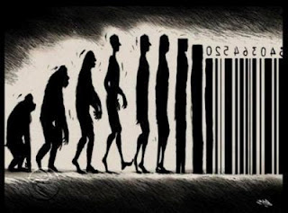
Digitizing money
Two ways to do it
Create digital cash
Create digital checks

Slide 5


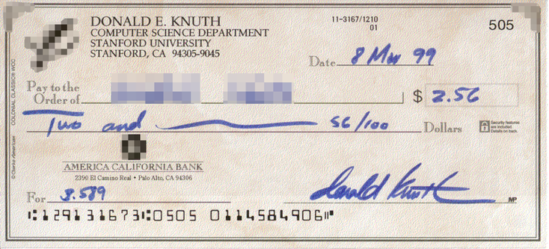
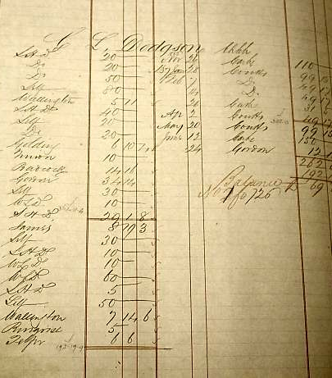

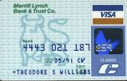
Bank accounts

Slide 6


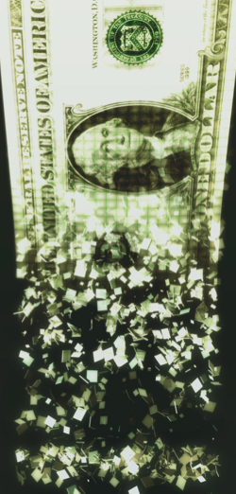
Digital cash
Can’t make uncopyable digital currency
Can make single use currency
Get a unique serial number when you withdraw money
Spend it by showing an unused serial number

Slide 7
E-Cash
Secure (hopefully)
Single use
Reliable
Low inflation
Privacy-preserving

Slide 8
E-Cash Crypto Protocols
Chaum82: blind signatures for e-cash
Chaum88: retroactive double spender identification
Brandis95: restricted blind signatures
Camenisch05: compact offline e-cash
Various practical issues:
Need for trusted central party
Computationally expensive
Etc.

Slide 9
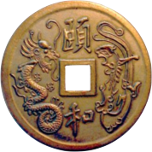
An ideal digital currency
Decentralized
Secure
Anonymous

Slide 10
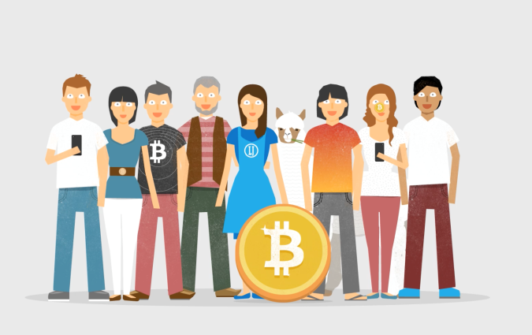
“What is Bitcoin” – Video
http://weusecoins.com

Slide 11
Blockchain Defined
Simply defined, a Blockchain is little more than a:
Distributed
Secure
Logfile
A digital currency was in a lot of ways the first demonstrable use

Slide 12

Bitcoin
A distributed, decentralized digital currency system
Released by Satoshi Nakamoto 2008
Effectively a bank run by an ad hoc p2p network
Digital checks
A distributed transaction log

Slide 13
Size of the BitCoin Economy
Number of BitCoins in circulation ~18 million
Total number of BitCoins generated cannot exceed 21 million – last coin to be produced in 2140
Average price of a Bitcoin: around $8000 as of now
Price has been varying.
Total balances held in BTC 100B$ compared with 1,200B$ circulating in USD (maybe outdated)
~200 Transactions per second. (Visa transaction 200,000 per minute.)
Notes:
https://www.buybitcoinworldwide.com/how-many-bitcoins-are-there/
https://bitinfocharts.com/bitcoin/

Slide 14
What is Bitcoin
A protocol that supports a decentralized, pseudo-anonymous, peer-to-peer digital currency
A publicly disclosed linked ledger of transactions stored in a blockchain
A reward driven system for achieving consensus (mining) based on “Proofs of Work” for helping to secure the network
A “scare token” economy with an eventual cap of about 21M bitcoins

Slide 15
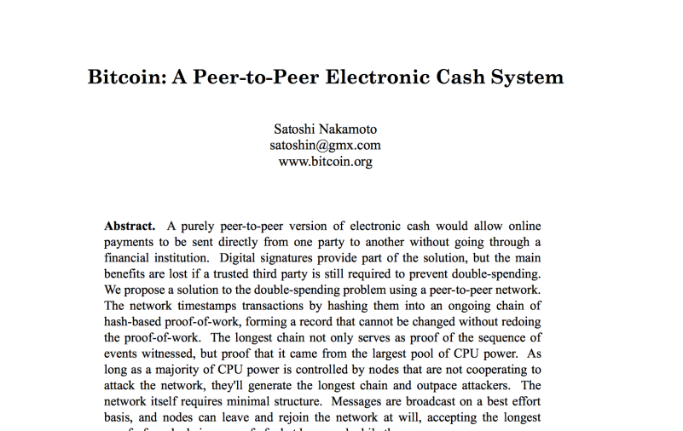
Bitcoin Whitepaper – 2008.10.31*
* Halloween

Slide 16
Features of Bitcoin
Essentially it’s “deflationary” – the reward is cut in half every four years, and tokens can be irrevocably destroyed or lost
Nearly infinitely divisible currency units supporting eight decimal places 0.00000001 (known as a Satoshi or Noncent*)
Nominal transaction fee’s paid to the network
Same cost to send $.01 as $1,000,000
Consensus driven – no central authority
Counterfeit resilient
Cannot add coins arbitrarily
Cannot be double-spent
Non-repudiation – aka “gone baby gone” – no recourse and no one to appeal to return sent tokens
http://www.urbandictionary.com/define.php?term=Noncents

Slide 17
When did it start?
“Satoshi Nakamoto” created the reference implementation that began with a Genesis Block of 50 coins
2008
August 18 Domain name "bitcoin.org" registered^{[1]}.
October 31 Bitcoin design paper published
November 09 Bitcoin project registered at SourceForge.net
2009
January 3 Genesis block established at 18:15:05 GMT
January 9 Bitcoin v0.1 released and announced on the cryptography mailing list
January 12 First Bitcoin transaction, in block 170 from Satoshi to Hal Finney
https://en.bitcoin.it/wiki/History

Slide 18
BitCoin: Challenges
Creation of a virtual coin/note
How is it created in the first place?
How do you prevent inflation? (What prevents anyone from creating lots of coins?)
Validation
Is the coin legit? (proof-of-work)
How do you prevent a coin from double-spending?
Buyer and Seller protection in online transactions
Buyer pays, but the seller doesn’t deliver
Seller delivers, buyer pays, but the buyer makes a claim
Trust on third-parties
Rely on proof instead of trust
Verifiable by everyone
No central bank or clearing house

Slide 19
Security in Bitcoin
Authentication
Am I paying the right person? Not some other impersonator?
Integrity
Is the coin double-spent?
Can an attacker reverse or change transactions?
Availability
Can I make a transaction anytime I want?
Confidentiality
Are my transactions private? Anonymous?

Slide 20
Security in Bitcoin
Authentication → Public Key Crypto: Digital Signatures
Am I paying the right person? Not some other impersonator?
Integrity → Digital Signatures and Cryptographic Hash
Is the coin double-spent?
Can an attacker reverse or change transactions?
Availability→ Broadcast messages to the P2P network
Can I make a transaction anytime I want?
Confidentiality→ Pseudonymity
Are my transactions private? Anonymous?

Slide 21
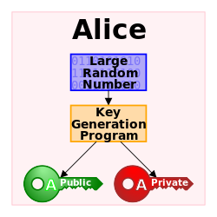
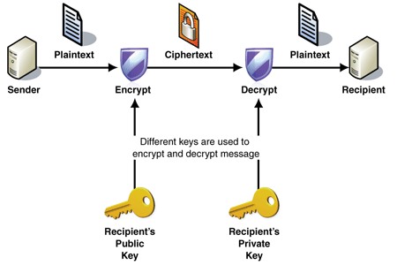
Public Key Crypto: Encryption
Key pair: public key and private key

Slide 22
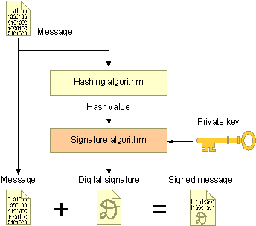
Public Key Crypto: Digital Signature
First, create a message digest using a cryptographic hash
Then, encrypt the message digest with your private key
Authentication
Integrity
Non-repudiation

Slide 23
Cryptographic Hash Functions
Consistent: hash(X) always yields same result
One-way: given Y, hard to find X s.t. hash(X) = Y
Collision resistant: given hash(W) = Z, hard to find X such that hash(X) = Z
https://en.wikipedia.org/wiki/Cryptographic_hash_function
Hash Fn
Fixed Size
Hash
Message of arbitrary length

Slide 24
Back to BitCoin
Validation
Is the coin legit? (proof-of-work) → calculate special Cryptographic Hash values
How do you prevent a coin from double-spending? → Broadcast to all nodes
Creation of a virtual coin/note
How is it created in the first place? → Mining, Provide incentives for miners
How do you prevent inflation? (What prevents anyone from creating lots of coins?) → Limit the creation rate of the BitCoins and total # of BitCoins
Notes:
https://en.bitcoin.it/wiki/Proof_of_work
https://en.bitcoin.it/wiki/Block_chain
https://www.quora.com/How-does-Bitcoin-prevent-double-spending
https://www.quora.com/How-does-Bitcoin-prevent-double-spending

Slide 25

Bitcoin Transactions
Public key 0xc7b2f68...
Public key 0xa8fc93875a972ea
Signature 0xa87g14632d452cd

Slide 26
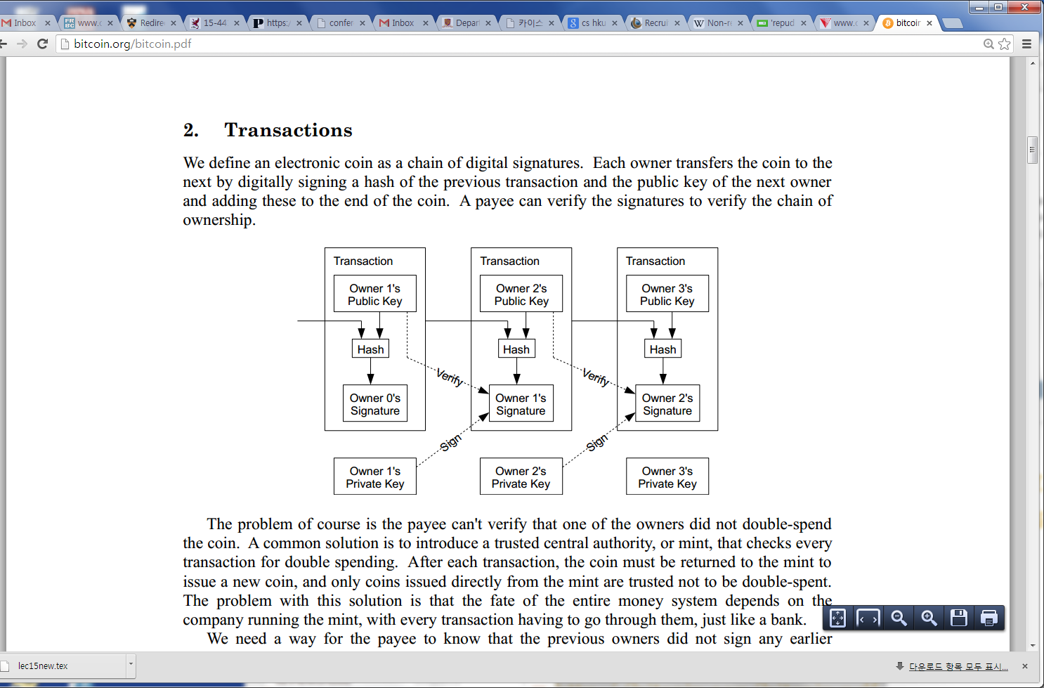
Bitcoin
Electronic coin == chain of digital signed transactions
BitCoin transfer: Sign(Previous transaction + New owner’s public key)
Anyone can verify (n-1)th owner transferred this to the nth owner
Anyone can follow the history
Given a BitCoin

Slide 27
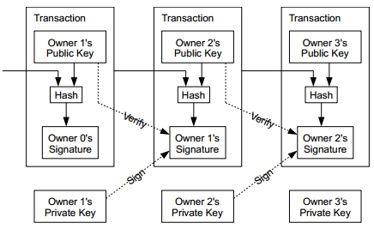
Coins flow from Inputs to Outputs
A coin owner transfers coins by digitally signing (via ECDSA) a hash digest of the previous transaction and the public key of the next owner. This signature is then appended to the end of the coin.

Slide 28
Bitcoin Network
Each P2P node runs the following algorithm:
New transactions are broadcast to all nodes.
Each node (miners) collects new transactions into a block.
Each node works on finding a proof-of-work for its block. (Hard to do. Probabilistic. The one to finish early will probably win.)
When a node finds a proof-of-work, it broadcasts the block to all nodes.
Nodes accept the block only if all transactions in it are valid (digital signature checking) and not already spent (check all the transactions).
Nodes express their acceptance by working on creating the next block in the chain, using the hash of the accepted block as the previous hash.

Slide 29
Decentralized
The “digital wallet” operates in a peer to peer mode
When it starts, it bootstraps to find other wallets
Originally it used the Internet Relay Chat (IRC) network
Now based on DNS and “seed nodes”
The wallet will synchronize with the network by downloading ALL of the transactions starting from the GENESIS block if necessary
604,000 blocks (November 2019)
Just over 291 GB (November 2019)
Using a “gossip protocol” the wallets share all transaction information with their peers http://en.wikipedia.org/wiki/Gossip_protocol
Notes:
https://bitinfocharts.com/bitcoin/

Slide 30
Addresses are like Accounts
The wallet listens for transactions addressed to any of its public keys and in theory is the only node that is able to decrypt and accept the transfer
“Coins” are “sent” by broadcasting the transaction to the network which are verified to be viable and then added to a block
Keys can represent a MULTI-SIG address that requires a N of M private keys in order to decrypt the message

Slide 31
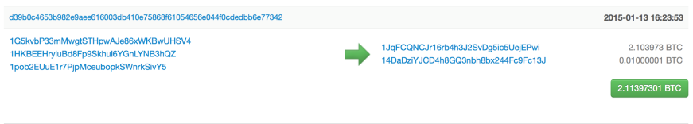
Pseudo Anonymous
Using public key cryptography, specifically Elliptic Curve Cryptography due to its key strength and shorter keys
Transactions are sent to public key “addresses”
1AjYPi8qryPCJu6xgdJuQzVnWFXLmxq9s3
1Give4dbry2pyJihnpqV6Urq2SGEhpz3K

Slide 32
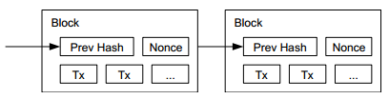
Public Ledger
Every viable transaction is stored in a public ledger
Transactions are placed in blocks, which are linked by SHA256 hashes.
https://blockchain.info

Slide 33
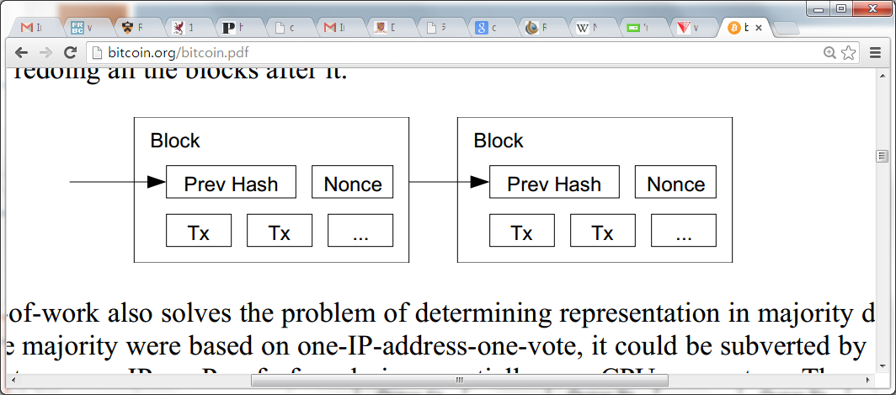
Use of Cryptographic Hashes
Proof-of-work
Block contains transactions to be validated and previous hash value.
Pick a nonce such that H(prev hash, nonce, Tx) < E. E is a variable that the system specifies. Basically, this amounts to finding a hash value who’s leading bits are zero. The work required is exponential in the number of zero bits required.
Verification is easy. But proof-of-work is hard.

Slide 34
Preventing Double-spending
The only way is to be aware of all transactions.
Each node (miner) verifies that this is the first spending of the Bitcoin by the payer.
Only when it is verified it generates the proof-of-work and attach it to the current chain.

Slide 35
Bitcoin Network
Each P2P node runs the following algorithm:
New transactions are broadcast to all nodes.
Each node (miners) collects new transactions into a block.
Each node works on finding a proof-of-work for its block. (Hard to do. Probabilistic. The one to finish early will probably win.)
When a node finds a proof-of-work, it broadcasts the block to all nodes.
Nodes accept the block only if all transactions in it are valid (digital signature checking) and not already spent (check all the transactions).
Nodes express their acceptance by working on creating the next block in the chain, using the hash of the accepted block as the previous hash.

Slide 36
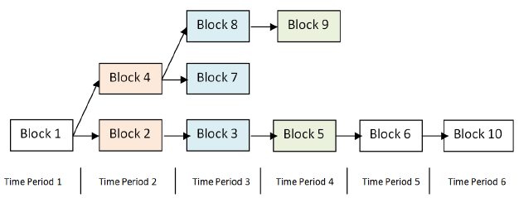
Arriving at Consensus
Although the accepted chain can be considered a list, the block chain is best represented with a tree.
The longest path represents the accepted chain.
A participant choosing to extend an existing path in the block chain indicates a vote towards consensus on that path. The longer the path, the more computation was expended building it.

Slide 37
Consensus Process = Mining
Originally the digital wallet could also participate in the consensus process by attempting to secure the network directly
This process is known as “mining”
Mining involves attempting to find a numerical value, known as a “nonce” that when combined with all open transactions can be “hashed” into a value that satisfies a certain “difficulty”
Custom, purpose built-hardware has long since replaced the function such that its no longer productive for simple CPU based systems to compete in the mining process, and thus it was removed

Slide 38
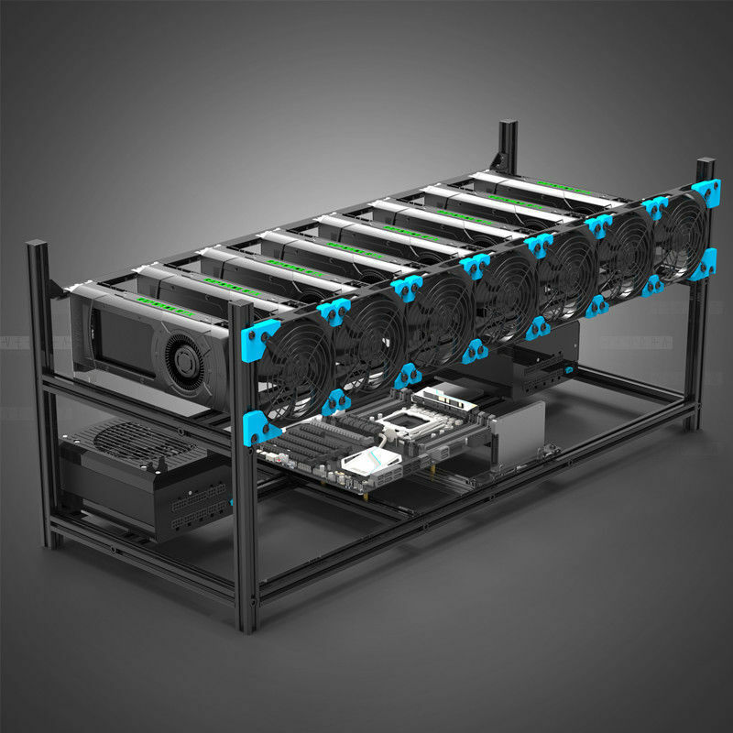

Slide 39
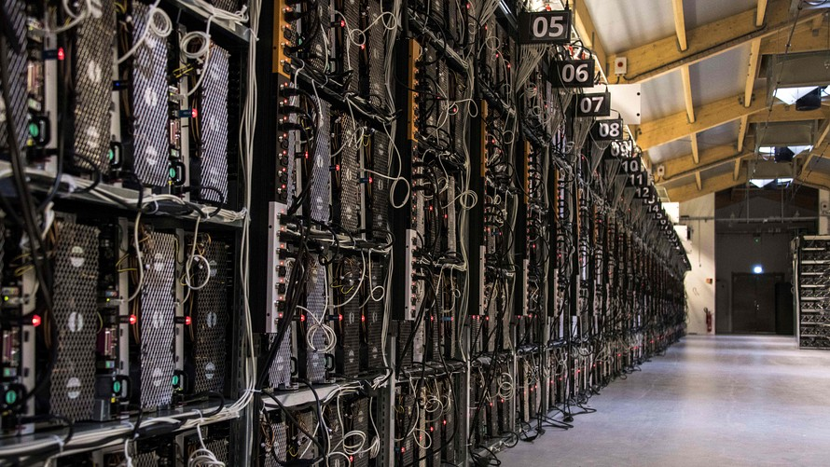

Slide 40
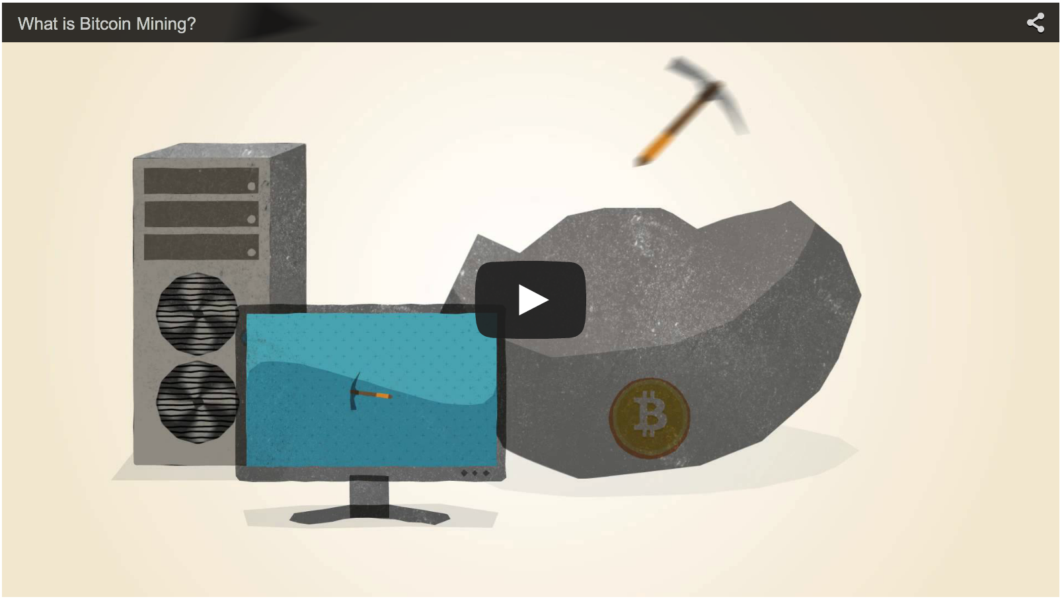
“What is Bitcoin Mining” – Video
http://www.bitcoinmining.com
Notes:
https://www.bitcoinmining.com/

Slide 41
Why 51% Matters
“When does 1 + 1 = 3 ?” *
In the case of Bitcoin, “consensus” goes to the chain with the highest number of blocks
Not just in theory, but in practice several large mining pools have generated six blocks in a row
To date the network has voluntarily shifted its mining power around or faced Distributed Denial of Service attacks
* When everyone says it does!

Slide 42
The Role of Hashing
A hash function is any function that can be used to map digital data of arbitrary size to digital data of fixed size, with slight differences in input data producing very big differences in output data.
MD5, SHA1, SHA256
Used for transactions and building blockchain blocks
For example, the MD5 hashes of ‘abc’ compared to ‘abC’
abc
0bee89b07a248e27c83fc3d5951213c1
abC
2217c53a2f88ebadd9b3c1a79cde2638
“The Quick Brown Fox Jumped Over the Lazy Dog”
2dfd75162490ed3b4c893141f9ab37cf

Slide 43
Proof of Work
A publicly auditable cost-function can be efficiently verified by any third party without access to any trapdoor or secret information.
A fixed cost cost-function takes a fixed amount of resources to compute. The fastest algorithm to mint a fixed cost token is a deterministic algorithm.
A probabilistic cost cost-function is one where the cost to the client of minting a token has a predictable expected time, but a random actual time as the client can most efficiently compute the cost-function by starting at a random start value. Sometimes the client will get lucky and start close to the solution.

Slide 44
The Hash Lottery
Hashing is straightforward, not challenging
Unless the goal is to say, find me a hash value that satisfies a certain level of “difficulty”
For example, the challenge is to find a hash-value that begins with a number of zeros, for a given input
The Proof of Work comes from finding a number (known as a NONCE) that when added to the input changes the output of the hash value to satisfy the difficulty
In the Bitcoin world this is what “mining” is and in effect is little more than a lot of hash-power spent on guessing winning lottery numbers that satisfy the difficulty of the problem in order to obtain the reward from the network

Slide 45
The Payout
The node that finds the best solution to the challenge is provisionally granted a reward
Originally in Bitcoin it was 50 new coins
Competing solutions are evaluated based on which node offers the higher number of transactions included in the candidate block as well as the level of over-satisfying the difficulty
For example, if two nodes offer a solution to the challenge and both have the same number of transactions, the reward will go to the node that found a NONCE that beat the challenge
E.G. Find a hash that begins with 4 zeros
The node that supplies a hash that has 5 zeros beats the node that only finds the minimum

Slide 46
Transaction Confirmation
Having a transaction provisionally accepted into a candidate block signals that the network has verified that the inputs were viable
Every new block accepted into the chain after the transaction was accepted is considered a confirmation
Coins are not considered mature until there have been 6 confirmations (basically an hour assuming a 10 minute block cadence)
New Coins created by the mining process are not valid until about 120 confirmations
This is to assure that a node with more than 51% of the total hash-power does not pull off fraudulent transactions

Slide 47
Confirmation of Transaction
Transactions are confirmed every time a new block is accepted into the chain
Why? Miners choose to add more blocks to the longest chain
Longer the chain, harder to modify

Slide 48
Tie breaking
Two nodes may find a correct block simultaneously.
Keep both and work on the first one
If one grows longer than the other, take the longer one
Two different block chains (or blocks) may satisfy the required proof-of-work.

Slide 49
Reverting is Hard
Reverting gets exponentially hard as the chain grows.
2. Recompute nonce
3. Recompute the next nonce
1. Modify the transaction (revert or change the payer)

Slide 50
Practical Limitation
At least 10 mins to verify a transaction
Agree to pay
Wait for one block (10 mins) for the transaction to go through
But, for a large transaction ($$$) wait longer. Because if you wait longer it becomes more secure. For large $$$, you wait for six blocks (1 hour).

Slide 51
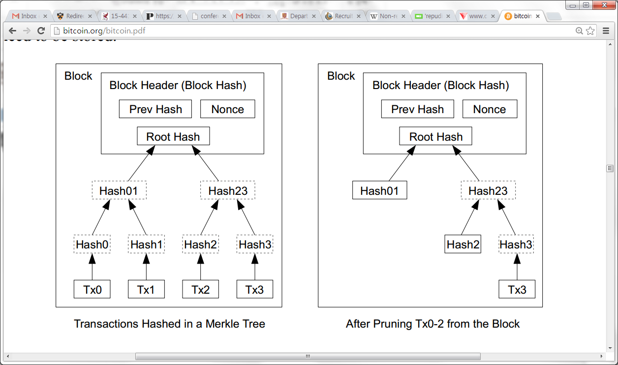
Optimizations
Merkle Tree
Only keep the root hash
Delete the interior hash values to save disk space
Block header only contains the root hash
Block header is about 80 bytes
80 bytes * 6 per/hr * 24 hrs * 365 = 4.2 MB/year
Why using a Merkle tree?
https://en.wikipedia.org/wiki/Merkle_tree

Slide 52
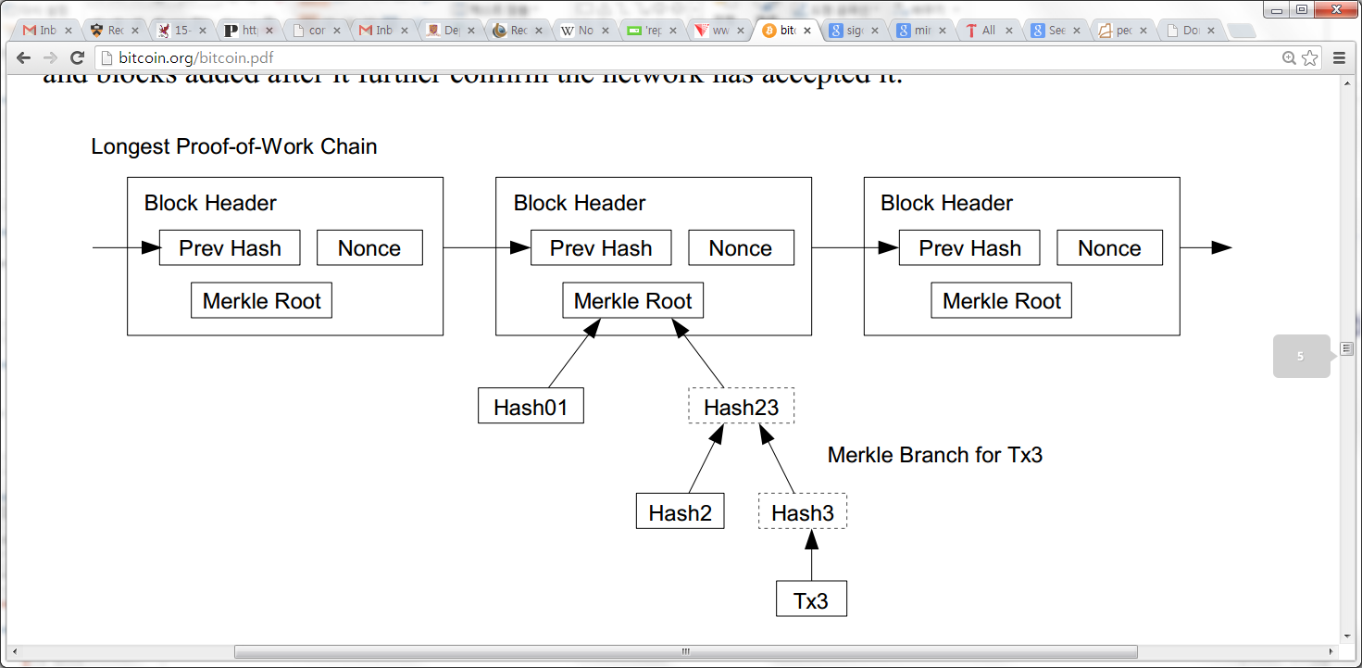
Simplified Payment Verification
Any user can verify a transaction easily by asking a node
First, get the longest proof-of-work chain
Query the block that the transaction to be verified (tx3) is in
Only need Hash01 and Hash2 to verify; not the entire Tx’s

Slide 53
BitCoin Economics
Rate limiting on the creation of a new block
Adapt to the “network’s capacity”
A block created every 10 mins (six blocks every hour)
How? Difficulty is adjusted every two weeks to keep the rate fixed as capacity/computing power increases
N new Bitcoins per each new block: credited to the miner → incentives for miners
N was 50 initially, in 2013, N=25
Halved every 210,000 blocks (every four years)
Thus, the total number of BitCoins will not exceed 21 million (After this miner takes a fee)
Notes:
https://www.varsitytutors.com/hotmath/hotmath_help/topics/infinite-geometric-series
6x24x365x4=209,664 blocks created in 4 years
50 bitcoins/block created in 2009
25 in 2013
12.5 in 2017
Infinite series sum = 50 * (1/(1-1/2)) = 100 → 210,000 x 100 = 21,000,000

Slide 54
Privacy Implications
No complete anonymity, only pseudonymity
All transactions remain on the block chain– indefinitely!
Retroactive data mining
Target used data mining on customer purchases to identify pregnant women and target ads at them (NYT 2012), ended up informing a woman’s father that his teenage daughter was pregnant
Imagine what credit card companies could do with the data

Slide 55
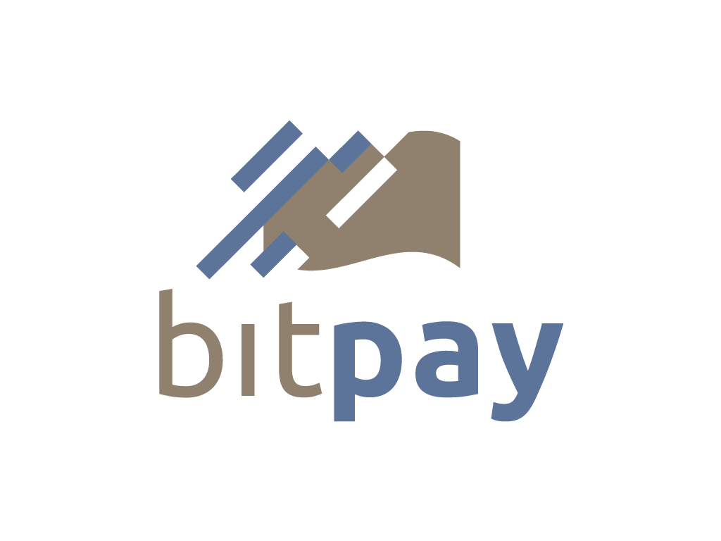
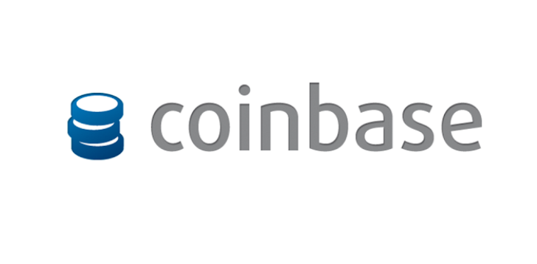

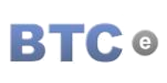
Purchase / Exchange Bitcoins
In addition to mining bitcoins, they can be acquired from an exchange!

Slide 56

Who Accepts Bitcoins?

Slide 57

Merchants Accepting Bitcoin
Overstock.com
Newegg.com
Microsoft XBOX Network
Telsa Motors
Time Inc (publisher)
Virgin Galactic
Wordpress
BitPay claims 44,000 merchants!
http://www.bitcoinvalues.net/who-accepts-bitcoins-payment-companies-stores-take-bitcoins.html

Slide 58
Other Uses of Blockchain Tek
Registeries
Authoritative Systems of Record
Directory Services
Timestamping Services (“Proof of Existence”)
Counter-party Exchanges
Smart contract

Slide 59
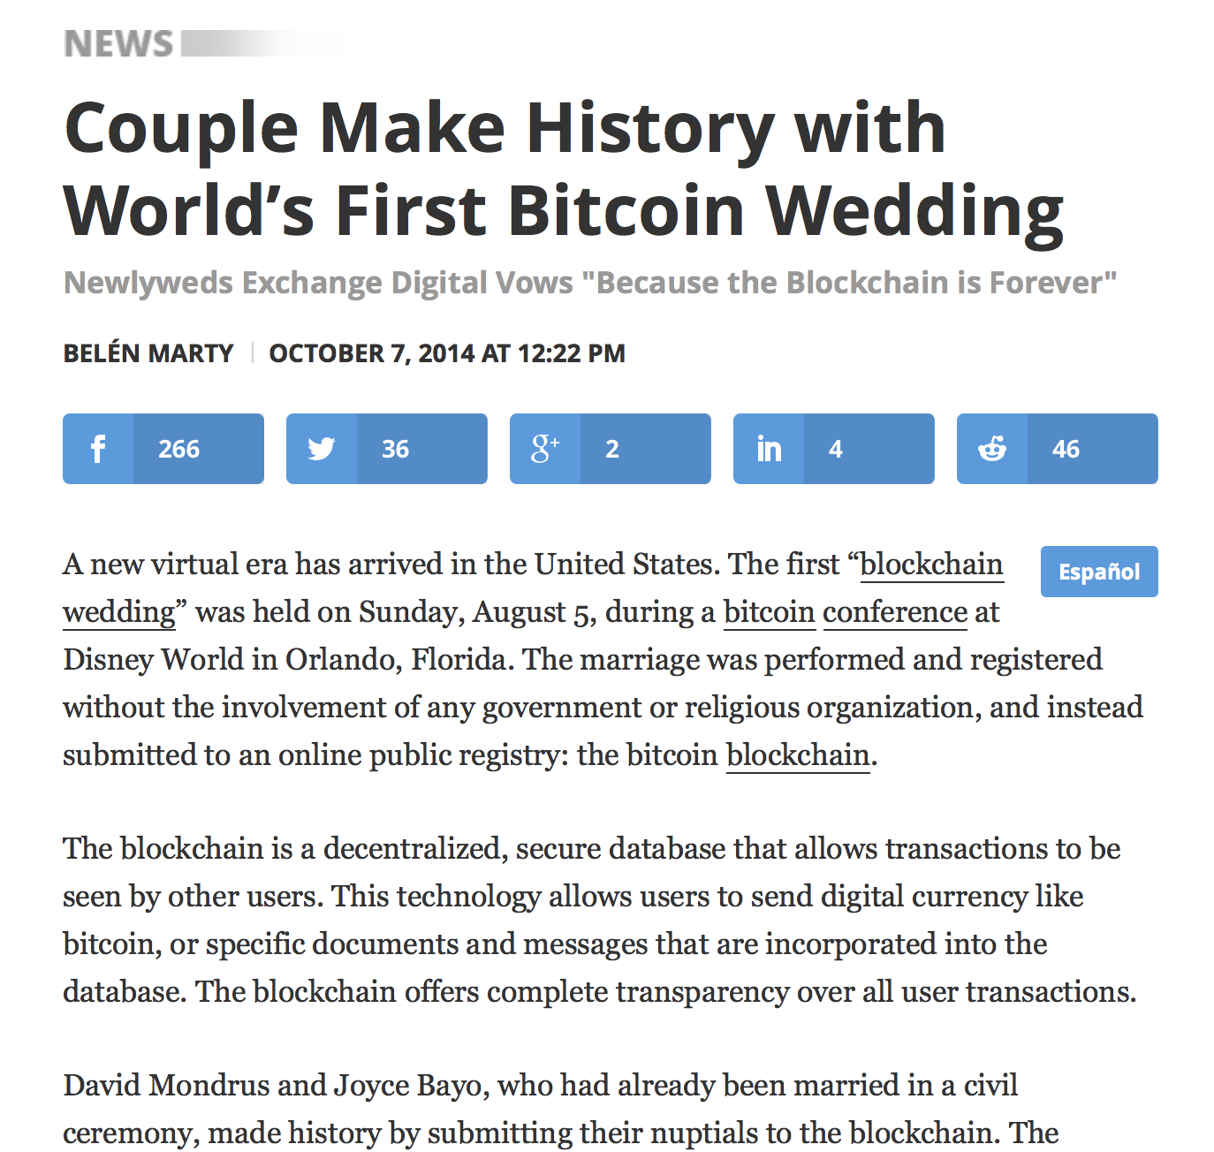
Registries

Slide 60
Zerocoin
A distributed approach to private electronic cash
Extends Bitcoin by adding an anonymous currency on top of it
Zerocoins are exchangeable for bitcoins
Notes:
Zerocoins are purchased with bitcoin in fixed denominations by a zerocoin mint transaction. Later, these zerocoins can be redeemed for bitcoin to a different bitcoin address by a zerocoin spend transaction. Through the use of cryptographic accumulators and digital commitments with zero-knowledge proofs, it is not possible to link the bitcoin address that was used to mint the original zerocoin to the bitcoin address used to redeem the zerocoin.

Slide 61

What is a zerocoin?
A zerocoin is:
Economically: a promissory note redeemable for a bitcoin
Cryptographically: an opaque envelope containing a serial number used to prevent double spending
823848273471012983

Slide 62

Commitments
812...
Allow you to commit to and later reveal a value
Binding: value cannot be tampered with
Blinding: value cannot be read until revealed
812..

Slide 63
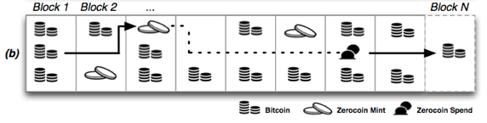
Zerocoins: where do they come from?
Anyone can make one
Choose a random serial number and commit to it
Mint a zerocoin by putting a mint transaction in the block chain which “spends” a bitcoin and includes the commitment
Spending a zerocoin gives the recipient a bitcoin
Notes:
Zerocoins are purchased with bitcoin in fixed denominations by a zerocoin mint transaction.

Slide 64
Zerocoins: ...and where do they go?
The “spent” bitcoins end up escrowed
To spend a zerocoin
You reveal the serial number
Prove it is from some zerocoin in the block chain
Put the spent serial number in the block chain

Slide 65
Zero-knowledge proofs
Zero-knowledge [Goldwasser, Micali 1980s, and beyond]
Prove knowledge of a witness satisfying a statement
Specific variant: non-interactive proof of knowledge
Here we prove we know:
The serial number of a zerocoin
That the coin is in the block chain

Slide 66

Zero-knowledge proof
Inefficient approach
Identify all valid zerocoins in the block chain (call them )
Prove that S is the serial number of a coin C and
This “OR” proof is O(N)
Zerocoin uses cryptographic accumulators
Sublinear

Slide 67



Zerocoin protocol
Generate a commitment to a random serial number S:
(Store serial number S and randomness r)
Accumulate all valid coins, compute witness wi
Reveal S and prove knowledge of witness to commitment accumulation and its randomness r
where is prime

Slide 68

Making Zerocoin
Zerocoins are just numbers
Each is a digital commitment to a random serial number
Anyone can make one!
823848273471012983

Slide 69


Making Zerocoin
Zerocoins are just numbers
They have value once you put them on the block chain
This costs e.g., 1 bitcoin
1.0,A->B
1.0,J->Z
.23,C->E
.23,E->F
.23,E->F
1.03,S->J
bitcoins
1.0,
1.2,E->J
.9,M->B
.9,M->B
2.5,M->S
.9B->D
.2,M->J
1.0->Z
1.0->Z
...
...
...
...
...
HASH
HASH
HASH
HASH
Block 1
Block 2
Block 3
Block 4
Block 5

Slide 70


Spending Zerocoin
1.0,A->B
1.0,J->Z
.23,C->E
.23,E->F
.23,E->F
1.03,S->J
bitcoins
1.0,
1.2,E->J
.9,M->B
1.0,Z->B
2.5,M->S
.9B->D
.2,M->J
1.0->Z
bitcoins
1.0->Z
...
...
...
...
...
HASH
HASH
HASH
HASH
Block 1
Block 2
Block 3
Block 4
Block 5

Slide 71

Spending Zerocoin
Where do the bitcoins go/come from?
Nowhere -- they get ‘escrowed’ in place
A Zerocoin spend transaction allows you to claim the coins left by some other Zerocoin user
1.0,A->B
1.0,J->Z
1.0,C->E
.23,E->F
.23,E->F
1.03,S->J
1.0,
1.2,E->J
.9,M->B
bitcoins
1.0,Z->B
2.5,M->S
.9B->D
.2,M->J
1.0->Z
1.0->Z
...
...
...
...
...
HASH
HASH
HASH
HASH
Block 1
Block 2
Block 3
Block 4
Block 5

Slide 72
Spending Zerocoin
Why is this anonymous?
It’s all in the way we ‘prove’ we have a Zerocoin
This is done using a zero knowledge proof
1.0,A->B
1.0,J->Z
1.0,C->E
.23,E->F
.23,E->F
1.03,S->J
1.0,
1.2,E->J
.9,M->B
.9,M->B
2.5,M->S
.9B->D
.2,M->J
1.0->Z
1.0->Z
...
...
...
...
...
HASH
HASH
HASH
HASH
Block 1
Block 2
Block 3
Block 4
Block 5

Slide 73
Spending Zerocoin
Zero knowledge [Goldwasser, Micali 1980s, and beyond]
Prove a statement without revealing any other knowledge
Specific variant: proof of knowledge
Here we prove knowledge of: (a) a Zerocoin in the block chain (b) we just revealed the actual serial number inside of it
The trick is doing this efficiently!

Slide 74

Spending Zerocoin
Inefficient proof
Identify all valid Zerocoins in the blockchain (call them )
Prove knowledge of such that:
These ‘or’ proofs have cost O(N)

Slide 75

Spending Zerocoin
Better approach
Use an efficient one-way accumulator
Accumulate to produce accumulator
Then prove knowledge of a witness s.t.

Slide 76
Discussion
The future of Bitcoin?
Attacks on Zerocoin?
Should we tradeoff privacy for usability? Is privacy a main principle?
Notes:
BitCoin FAQ

Slide 77
Acknowledgement
Some of the slides, content, or pictures are borrowed from the following resources, and some pictures are obtained through Google search without being referenced below:
L24-BitCoin and Security, many of the slides borrowed from this presentation with modifications.
Ian Miers, Zerocoin: Anonymous Distributed E-Cash from Bitcoin, IEE S&P slides

